Slide 1

LOVELY PROFESSIONAL UNIVERSITY
PROJECT
“PREDECTIVE ANALYTICS”
YASHWANT SINGH
UNDER THE GUIDANCE OF MRS. TANIMA THAKUR

Slide 2
Customer Churn Prediction

Slide 3
Problem Statement
Industry Outlook:
Economic instability and market saturation.
High competition with price wars.
Increasingly demanding and less loyal customers.
Business Need:
Churn impacts EBITDA* margin and revenue.
Customer acquisition costs are up to 5 times higher than retention.
*EBITDA stands for Earnings Before Interest, Taxes, Depreciation, and Amortization and is a metric used to evaluate a company's operating performance

Slide 4




OBJECTIVE
Develop a machine learning model to
Predict churn propensity at the individual level.
Identify key drivers of churn.
Propose actionable strategies for targeted retention campaigns.

Slide 5
OBJECTIVE
Develop a machine learning model to
Predict churn propensity at the individual level.
Identify key drivers of churn.
Propose actionable strategies for targeted retention campaigns.

Slide 6
Dataset Overview
Source: KAGGLES
data.Features: Age, Gender etc.
Service Usage: Call, internet usage etc.
Behavioral: Payment, Contract etc.
Target Variable:Churn: Binary (1 = churn, 0 = no churn).

Slide 7



Methodology
Data Preprocessing:
Model Selection:
Evaluation Metrics:
Dropped irrelevant columns and handled missing values.
Split data into training (70%) and testing (30%) sets.
Algorithms: Decision Tree, Balanced Decision Tree, Logistic Regression, Gradient Boosting, SVM.
Balanced data using ROSE for fairer predictions.
Precision, Recall, F1 Score, Accuracy.

Slide 8
Model Workflow
Steps:
Data loading and preprocessing.
Baseline Decision Tree without balancing.
Enhanced Decision Tree with balanced data (ROSE).
Comparison with Logistic Regression, Gradient Boosting, and SVM.
Visualization of model performance metrics.

Slide 9
Algorithm Comparison
Algorithm Comparison
Overview of Model Performance
Overview of Model Performance
Metric | Decision Tree | Balanced Decision Tree | Logistic Regression | Gradient Boosting | SVM
Precision | 0.82 | 0.9 | 0.83 | 0.83 | 0.79
Recall | 0.90 | 0.72 | 0.90 | 0.91 | 0.95
F1 Score | 0.86 | 0.80 | 0.86 | 0.87 | 0.86
Accuracy | 74% | 74% | 80% | 80% | 78%

Slide 10
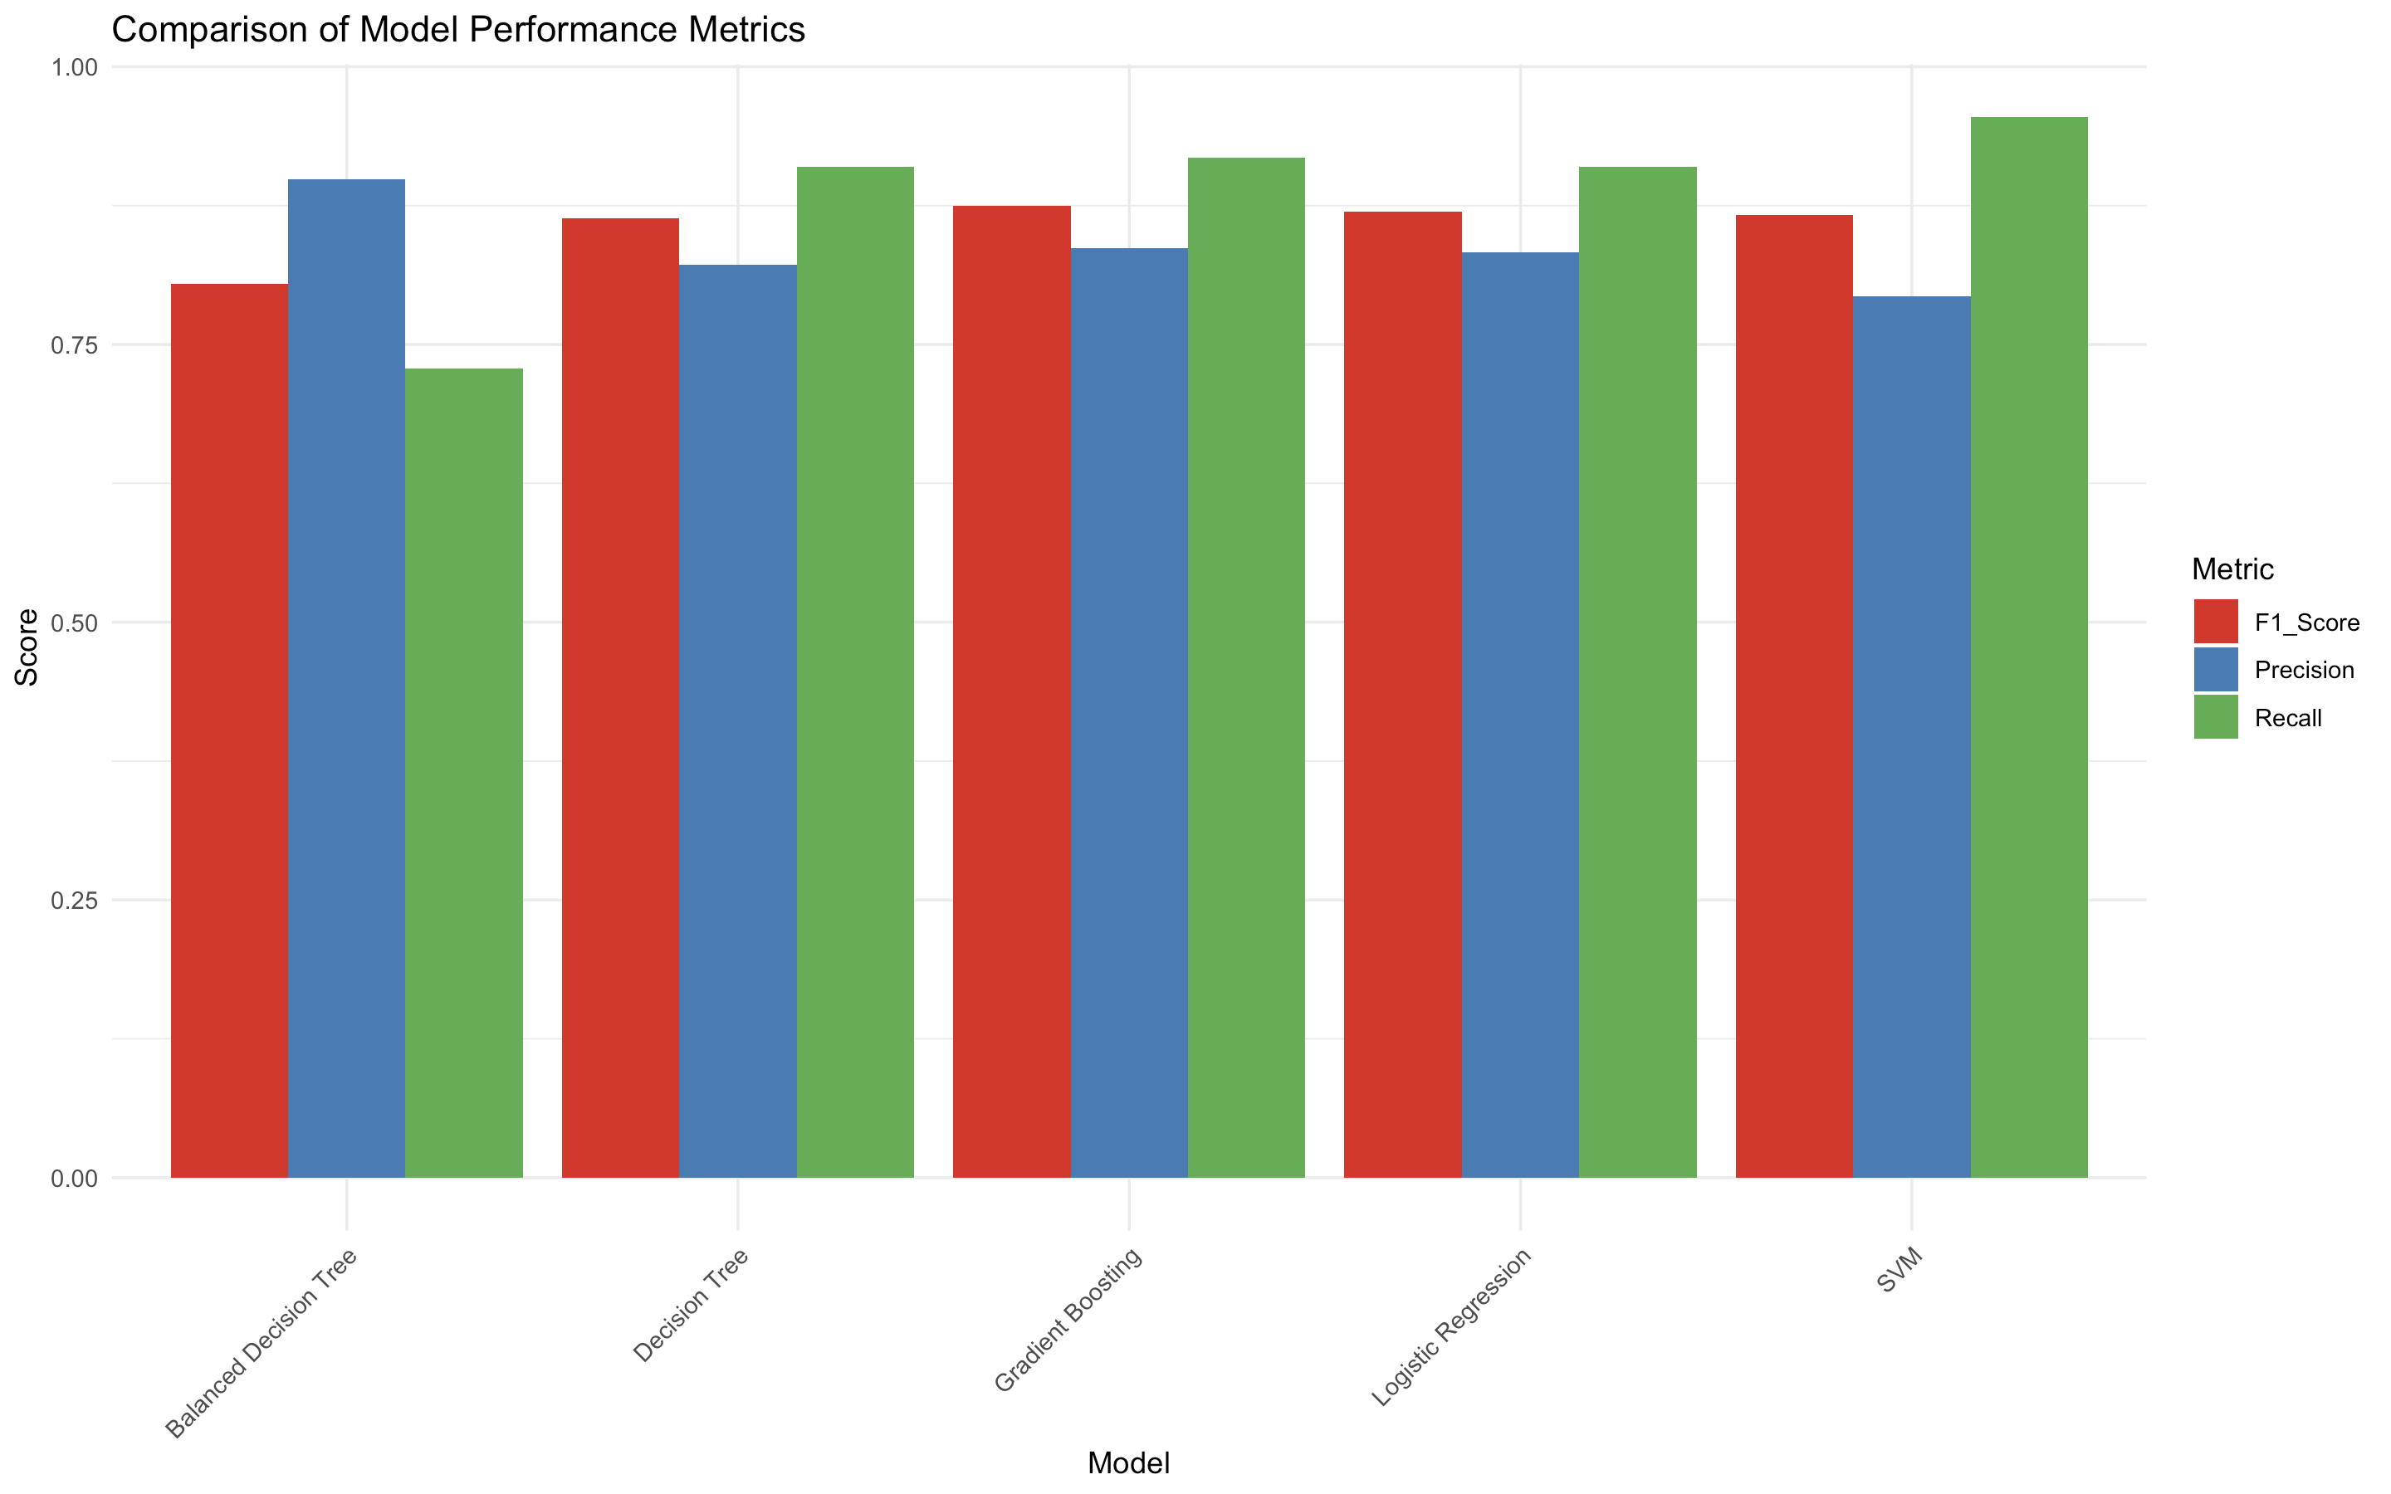
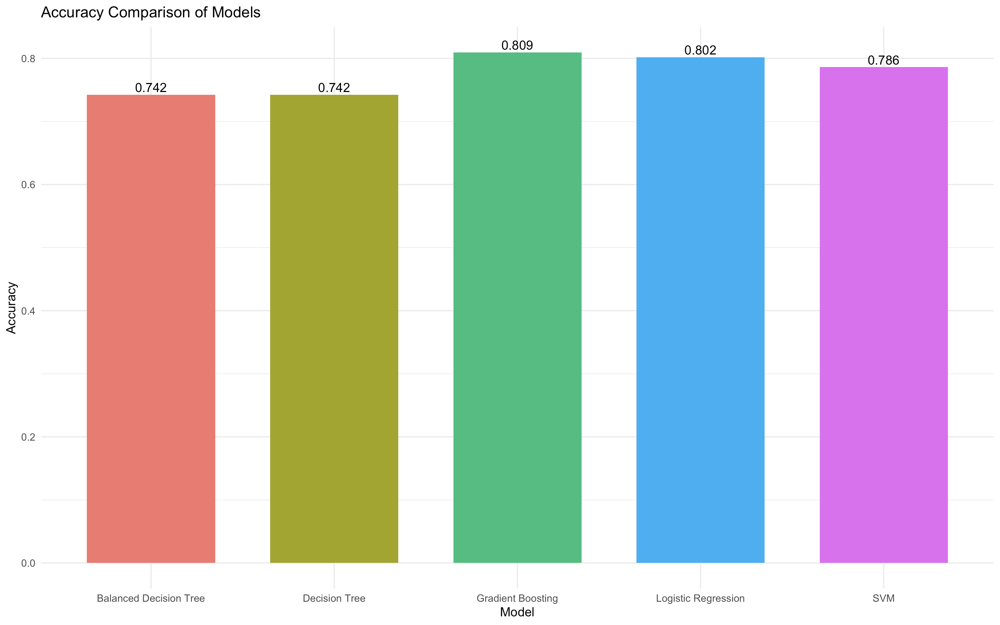
Visuals
Comparing Precision, Recall, and F1 scores across models.
Accuracy comparison across models.

Slide 11
Model Performance Metrics
Results Summary:
Models evaluated: Decision Tree, Balanced Decision Tree, Logistic Regression, Gradient Boosting, SVM.
Final model selected: Gradient Boosting Tree with:
Precision: 0.83
Recall: 0.91
F1 Score: 0.87
Accuracy: 80%.

Slide 12
Insights and Interpretations
Key Drivers of Churn:
Late payments, high complaints, low data usage.
Customer Segments at Risk:
Young customers with low service engagement.
Expected Business Impact:
Identify churners early and reduce churn by 15%-20%.
Improve ROI by reducing acquisition costs.

Slide 13
Conclusion
Key Takeaways:
Data-driven approach to optimize retention.
Final model provides actionable insights for targeted marketing.
Significant cost savings by focusing on retention over acquisition
Future Work:
Incorporate more granular customer behavior data.
Explore advanced algorithms like Neural Networks.

Slide 14
THANK YOU

